Slide 1
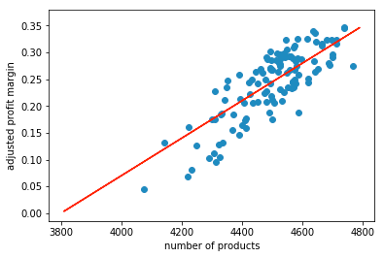

Slide 2
Simple equation for driving and estimating store’s profit margin, ignoring all cost factors
Profit margin = .00038 * number of products - 1.48
Ex:
Location 1 in TX:
Profit margin = .00035 * 4452 products - 1.33
Predicted profit margin = .22
Profit margin was ,28

